Slide 1
EDES 301 Les PocketBeagle Proposal
22/02/25
Tomi Kuye

Slide 2

Background Information
Guitar Hero is my favorite video game!
I currently play ~5-6 hrs a week when I can
According to this list I’m at a level 12 (currently hitting 93% of notes in WWWY on Expert)
My favorite guitar hero game is Guitar Hero 3: Legend of Rock! (great soundtrack)!
I would love to improve my skills but there are a couple of problems:
The only Wii I have available to me is in my Residential College (I can’t hog the Wii and play even more than I currently do)
I am getting bored of playing GH3 all the time! Guitar Hero has also stopped producing new games.
Guitar Hero guitars are really expensive ($60 - $100) and working ones are hard to find.
*WWWY -> While We Were Young

Slide 3

Background Information
Alternative: Clone Hero!
Open Source application that serves as a clone for classic guitar/instrument rhythm games like Rock Band and Guitar Hero
Problem | How Clone Hero Solves it
The only Wii I have available to me is in my Residential College (I can’t hog the Wii and play even more than I currently do) | I can play Clone Hero on my PC!
I am getting bored of playing GH3 all the time! Guitar Hero has also stopped producing new games. | Clone Hero has a larger array of songs, mapped by other players : can finally play all of the Weezer I want.
Guitar Hero controllers are really expensive ($60 - $100) and hard to find. | UNSOLVED: Clone Hero still needs a compatible 5-6 fret guitar controller! Even worse, not all guitar hero controllers are compatible :( and require lots of modding

Slide 4
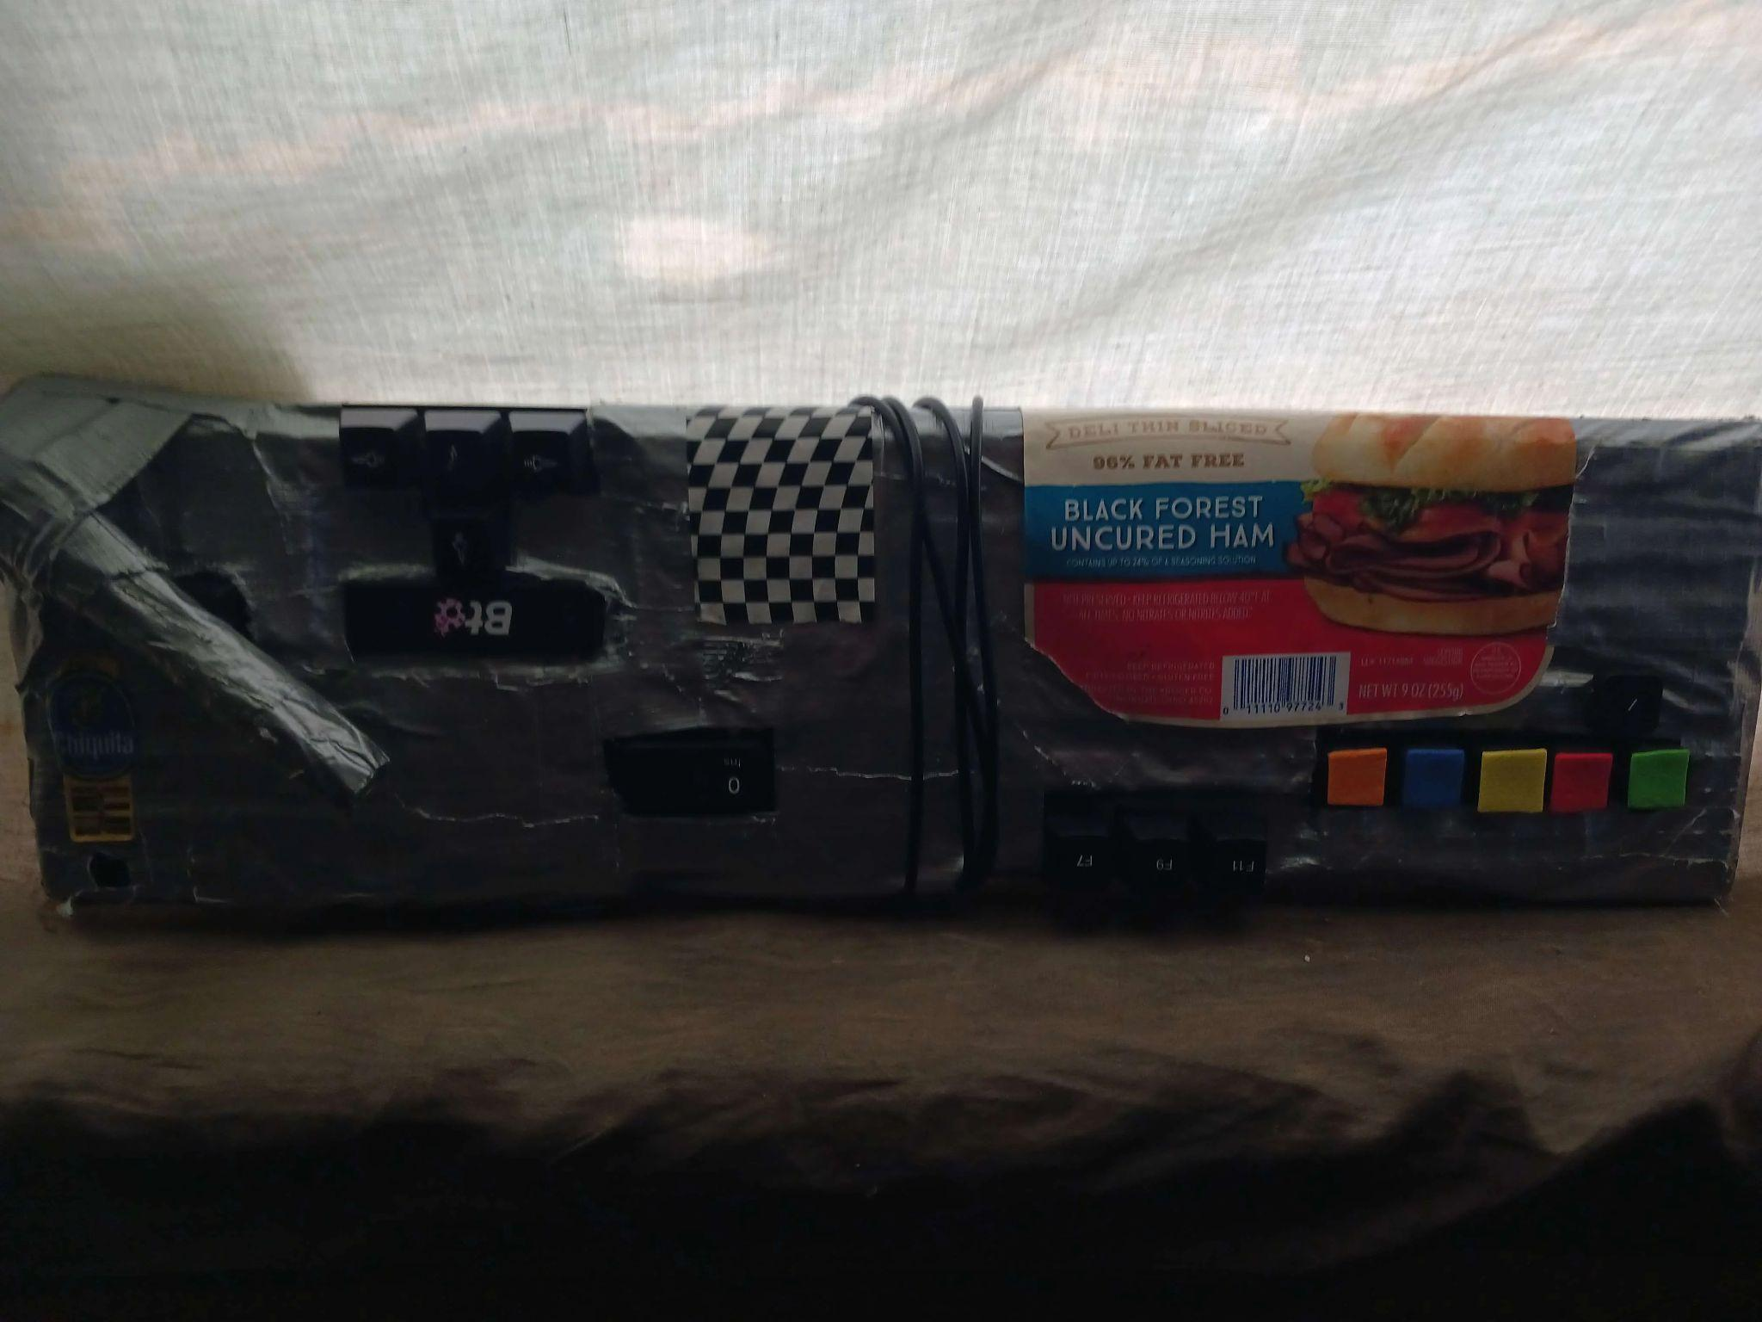
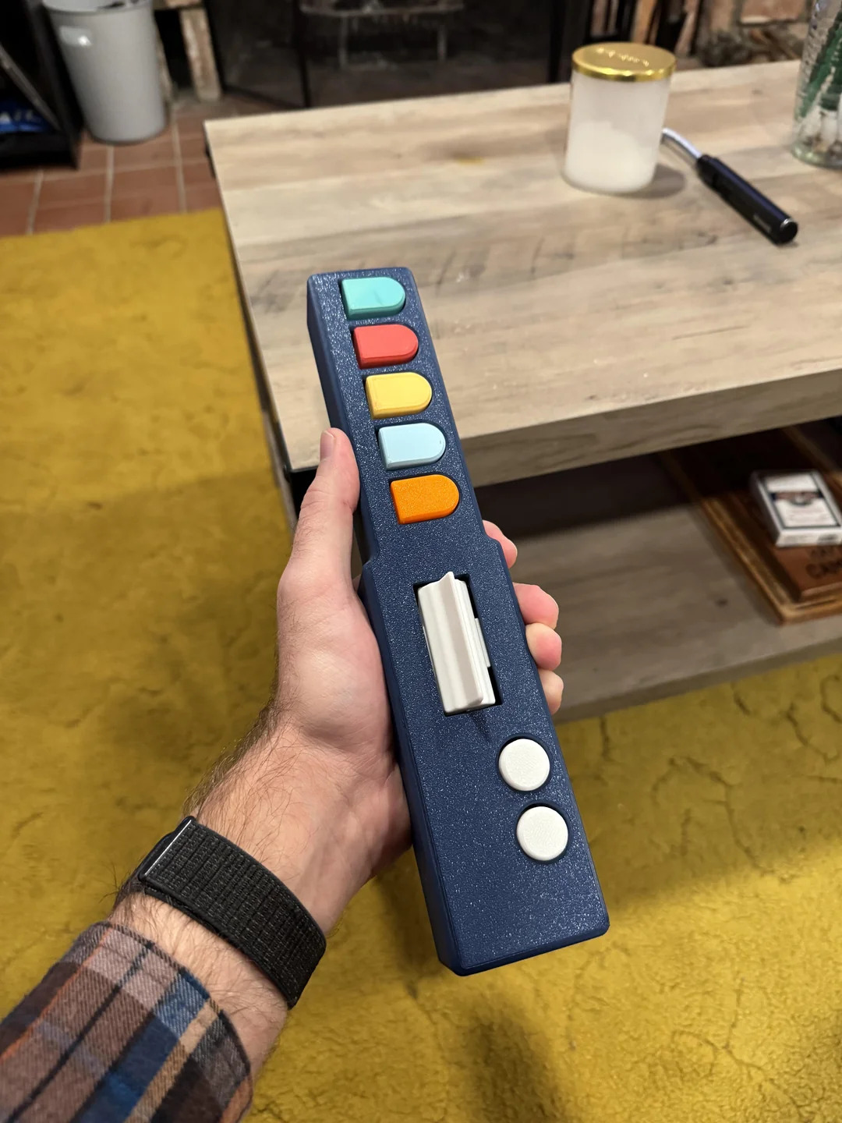
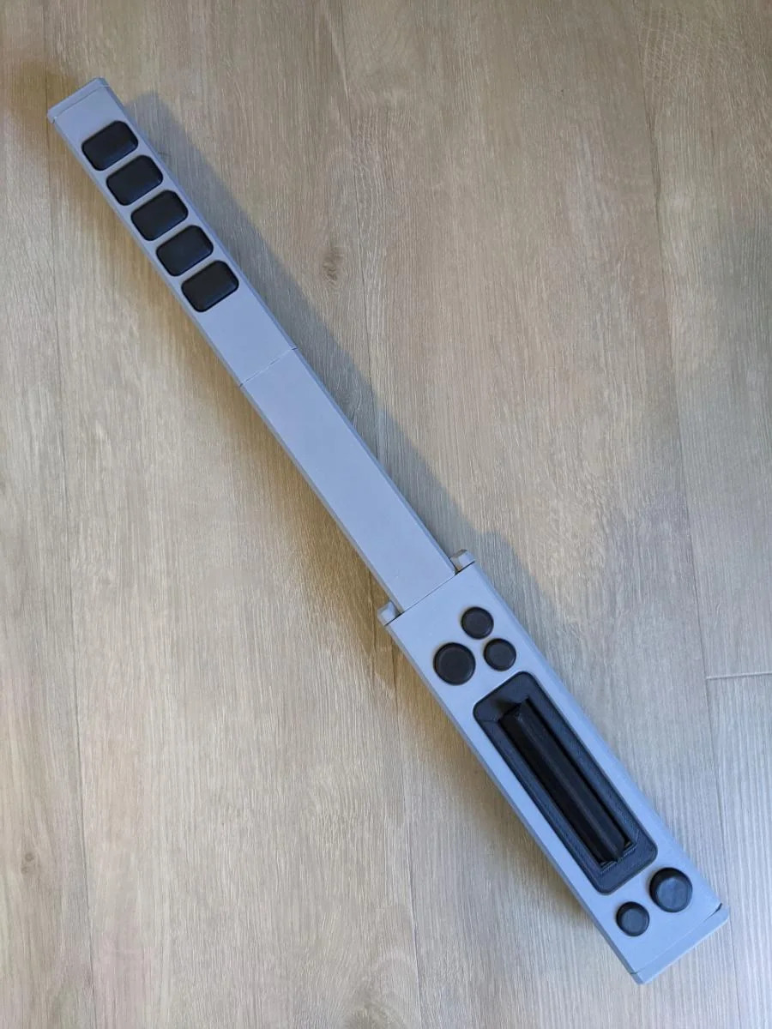
Solutions
Clone Hero Users have been searching for a consistent controller solution, and valiant efforts have been made to DIY one:
Polybar, open source
Ham by u/Kiwi8675309 (just a literal keyboard + ductape)
u/JustLovett0, plans to monetize, inspired by polybar
GamerAxe (indefinite hiatus)
NoteStriker (indefinite hiatus)
Polybar has made most progress, most online users.
However it’s a wired controller 😔
Great for low-latency, but not true to the Les Paul experience.
ham, by u/Kiwi8675309
Fun Fact: The Les Paul GH3 controller was the first controller in the series to be wireless
u/JustLovett0
polybar

Slide 5
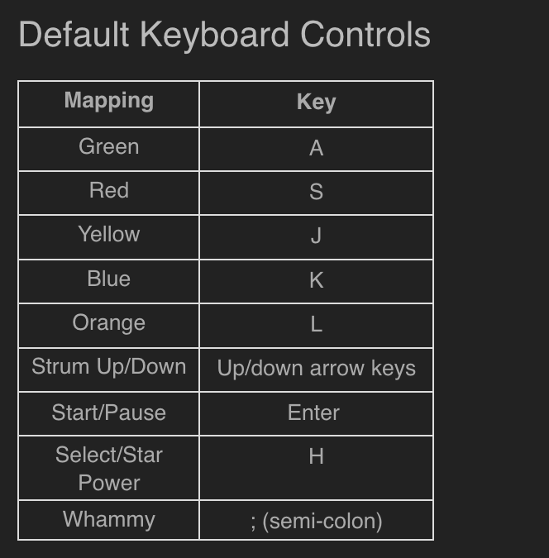
My Solution: Les PocketBeagle
A 5 fret low latency (~10 ms) wireless Clone Hero compatible controller, driven by the PocketBeagle, modelled after the classic Les Paul guitar. Complete with a “whammy” bar and tilt activation of “star power”.
Clone Hero can be played with keyboard: It will be a wireless macro keyboard shaped into a guitar, with a tilt sensor that also maps to a keyboard input.
I want Individually addressable LEDs on the guitar
Have them all be “star power blue” when star power activated and
regular GRYBO when playing without starpower for an added challenge
https://wiki.clonehero.net/link/11#bkmrk-default-keyboard-con

Slide 6
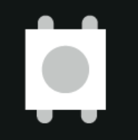
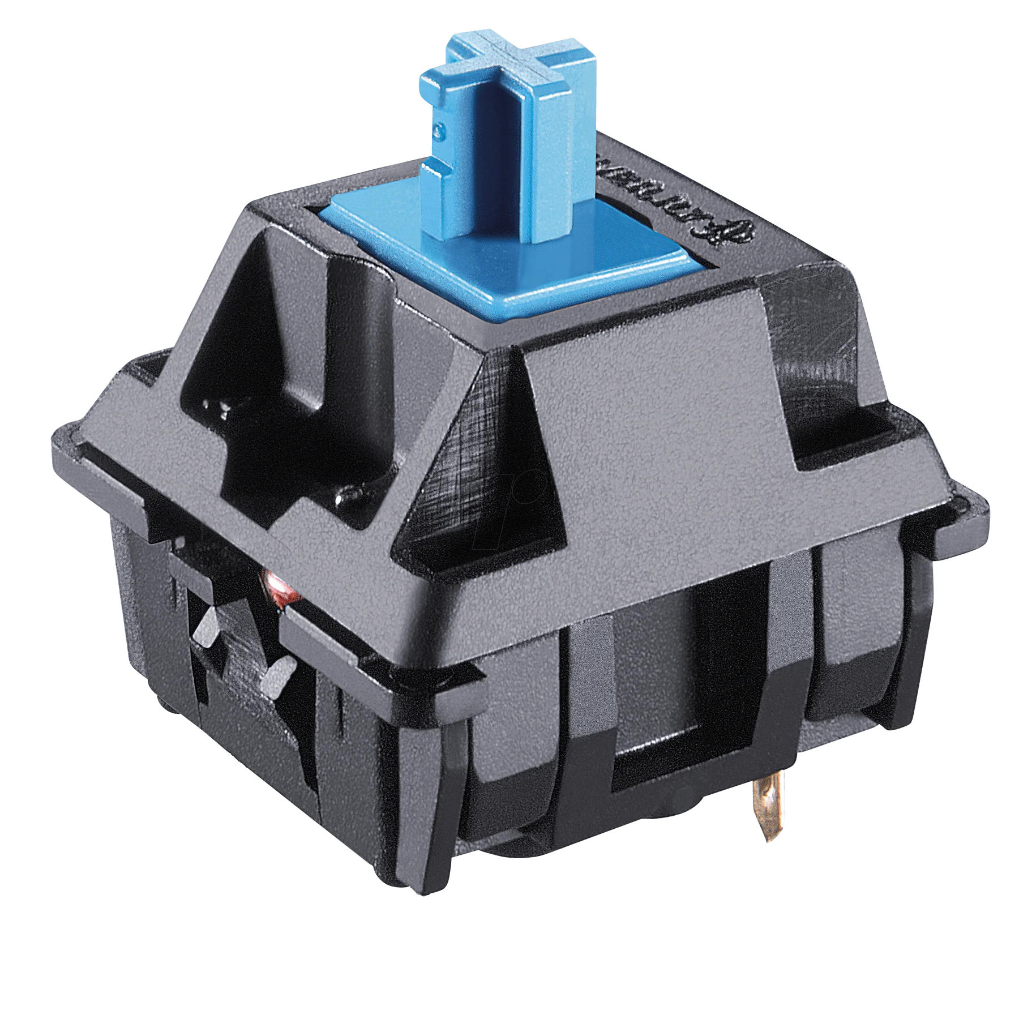

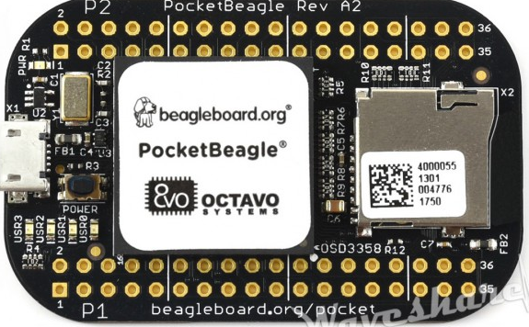
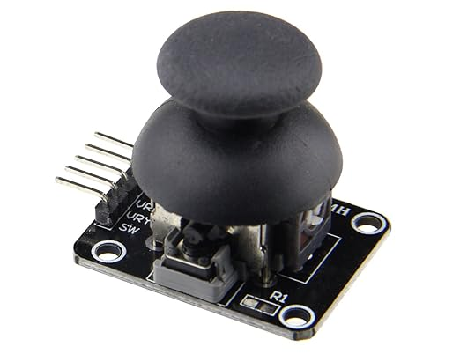
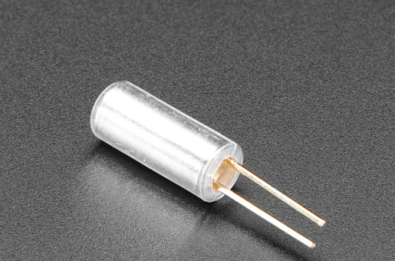
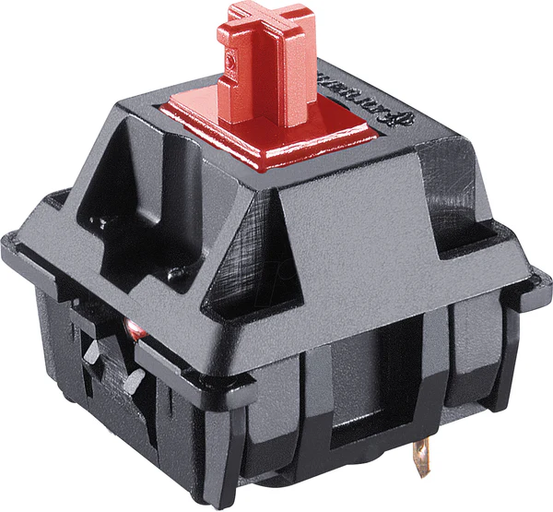
System Block Diagram
Cherry Mx Blue Switches. (Strum bar)
Ws2812b Leds
Bluetooth
Joystick
Tilt ball sensor
Cherry Mx Switches (Frets)
Key
Green arrow = GPIO IN
Red arrow = GPIO OUT

Slide 7
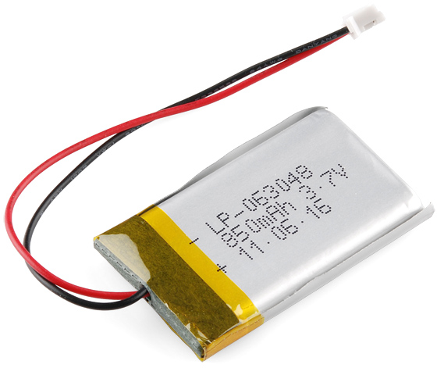
Power Block Diagram
Cherry Mx Blue Switches. (Strum bar)
Ws2812b Leds
+3.7V
3.7V
D_out
Bluetooth
Joystick
Tilt ball sensor
3.7V
3.7V
Cherry Mx Switches (Frets)

Slide 8
Components / Budget
Component | EDES301 to Buy? | Cost
Kalih Cherry Mx Switch | Yes | 6.65
Blue Switches x2 | Yes | 2.00
Tilt Switch | Yes | 7.98
WS2812b Leds | No
Usb Bluetooth | Yes | 9.99
Joystick | Yes | 1.33
Tactile Buttons | No
Can the Keyboard Switches be considered One component? And I will be providing my own WS2812b LEDS
Total EDES301 Contribution: $27.95

